Slide 1
Using bar models to represent known times tables
Mathematics
Miss Brinkworth

Slide 2
Part A
Draw a bar model for each of the following.
Now write a number sentence for each
There are 3 school bags with 5 books in each. How many books are there altogether?
There are 3 bags each with 3 sweets in each. How many sweets are there altogether?

Slide 3
Part B
Draw your own bar-models to answer these questions
There are 9 rows on an plane. Each row holds 4 people. What is the total number of passengers the plane can take?
Nigel needs 4 eggs to make a cake. How many eggs does he need to make 6 cakes?

Slide 4
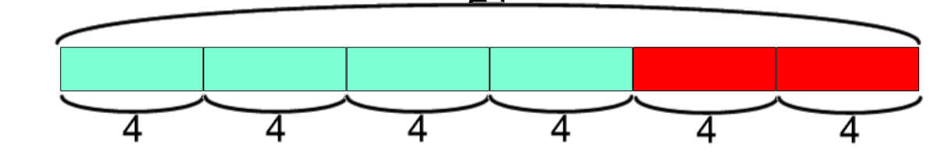
Part C - Challenge
What question might this bar model be used to answer?

